Slide 1
KINDS OF TECHNICAL REPORTS

Slide 2
Things you should decide before writing a technical report:
Report topic: Decide what subject you are going to write on; narrow it as much as possible.
Report audience: Define a specific person or group of people for whom you are going to write the report. Define the circumstances in which this report is needed.
Report purpose: Define what the report will accomplish--what needs of the audience it is going to fulfill.
Report type: Decide on the type of report--for example, technical background report, feasibility report, instructions, or some other.

Slide 3
For the final report, you can write one of (or even a combination) of several different types of reports. These choices are not meant to be restrictive, but to indicate a range of possibilities.

Slide 4
SOME BASIC TYPES OF TECHNICAL REPORT
Instructions
Organizational policies and procedures
Feasibility, evaluation,
Recommendation reports
Technical background reports
Primary research reports
Business plans
Technical specifications

Slide 5
INSTRUCTIONS
One of the most common and one of the most important uses of technical writing is instructions.
It is a familiar how-to document that guides you step by step through tasks such as assembling, operating, and repairing things, or do routine maintenance on something.

Slide 6
CHARACTERESTICS OF GOOD INSTRUCTION WRITING
Clear, simple writing
A thorough understanding the procedure in all its technical detail
Your ability to put yourself in the place of the reader, the person trying to use your instructions
Your ability to visualize the procedure in great detail and to capture that awareness on paper
Finally, your willingness to go that extra distance and test your instructions on the kind of person you wrote them for.

Slide 7
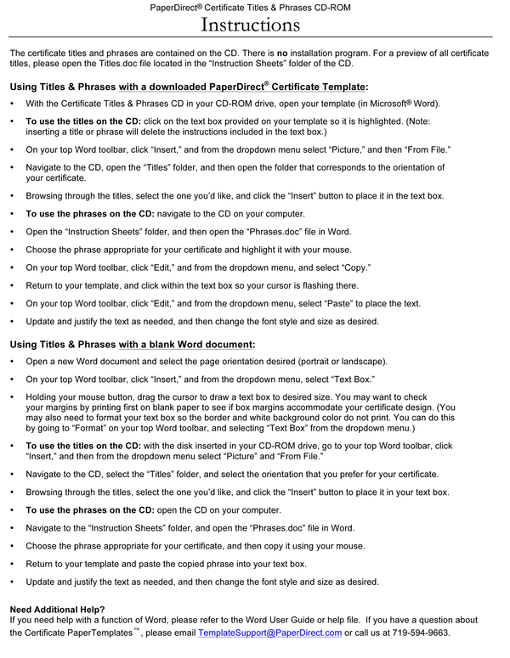

Slide 8
ORGANIZATION POLICIES AND PROCEDURES

Slide 9
These are the operating documents for organizations; they contain rules and regulations on how the organization and its members are expected to perform. Policies and procedures are like instructions, but they go much further.

Slide 10
These can include whatever the organizations considers important for its operations:
-Attendance policies
-Substance-abuse policies
-Work-flow procedures
and so on…
Once recorded, the policies and procedures are there for everybody in the organization to refer to, and these documents become the means of settling most disputes within the organization.

Slide 11
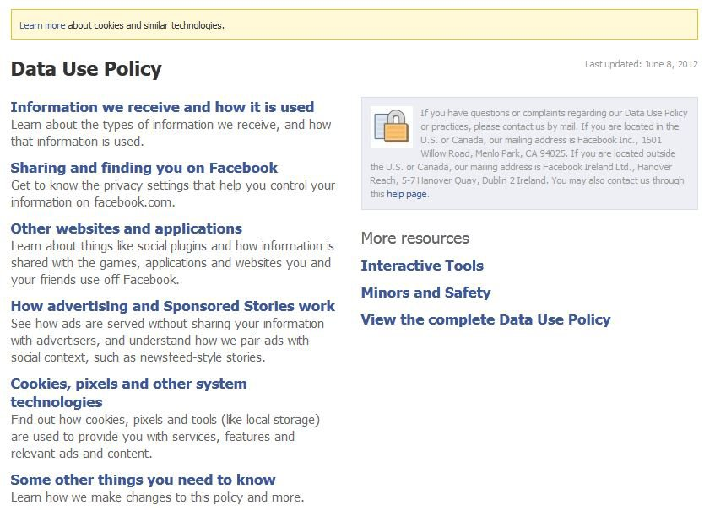

Slide 12
Recommendation and
Feasibility Reports

Slide 13
This group of similar reports does things like compare several options against a set of requirements and recommend one; considers an idea (plan, project) in terms of its "feasibility," in terms of some combination of its technical, economical, social practicality or possibility; passes judgment on the worth or value of a thing by comparing it to a set of requirements, or criteria.

Slide 14
Feasibility report:
This type studies a situation (for example, a problem or opportunity) and a plan for doing something about it and then determines whether that plan is "feasible.“
The feasibility report answers the question "Should we implement Plan X?" by stating "yes," "no," but more often "maybe." Not only does it give a recommendation, it also provides the data and the reasoning behind that recommendation.

Slide 15
Recommendation report:
This type starts from a stated need, a selection of choices, or both and then recommends one, some, or none.
The recommendation report answers the question "Which option should we choose?" (or in some cases "Which are the best options?) by recommending Product B, or maybe both Products B and C, or none of the products.

Slide 16
Evaluation report:
This type provides an opinion or judgment rather than a yes-no-maybe answer or a recommendation. It provides a studied opinion on the value or worth of something.
This type of report compares a thing to a set of requirements (or criteria) and determines how well it meets those requirements. (And of course there may be a recommendation--continue the project, scrap it, change it, or other possibilities.)

Slide 17
Technical background reports.

Slide 18
The technical background report is hard to define--it's not a lot of things, but it's hard to say what it is.
It focuses on a technical topic, provides a certain background on that topic for a specific set of readers who have specific needs for it.

Slide 19
It doesn't provide step-by-step directions on how to do something the way that instructions do.
It does not formally provide recommendations the way that feasibility reports do.
It does not report data from original research and draw conclusions the way that primary research reports do.

Slide 20
Technical background reports may include:
Definitions
Causes
Effects
Types
Historical background
Processes
Descriptions
Comparisons
Applications
Advantages and disadvantages
Economic considerations
Social, political, legal, ethical implications
Problems, questions
Solutions, answers

Slide 21
Primary research reports

Slide 22
Primary research report is our name for that kind of report that presents original research data--no matter whether that data was generated in a laboratory or out in the "field." A secondary research report then would be a report that presents information gained largely from printed information sources or from other sources such as people.
You're probably already familiar with this type of report as the "lab report."

Slide 23
Contents of a research report
Introduction
Problem, background
Purpose, objectives, scope
Review of literature
Materials, equipment, facilities
Theory, methods, procedures
Results, findings, data
Discussion, conclusions, recommendations
Bibliography

Slide 24
BUSINESS PLANS

Slide 25
A business plan is very much like a proposal, except for at least one big difference.
The business plans seeks to start a new business or significantly expand an existing business.
A proposal, on the other hand, seeks approval to do a specific project.

Slide 26
For example, a business plan might seek funding and other support to start a software company to create computer games. A proposal, on the other hand, might bid to do the development work for some specific computer game.

Slide 27
For your plan, you'll need to think about the best sequencing of the sections, typical sections may include:
Service
Market for the product or service
Process by which the product or service is produced
Facilities and personnel needed for the operation
Projected revenues from the operation
Funding necessary for startup and operation
Legal issues related to the proposed business

Slide 28
Qualifications and background of the personnel
Discussion of feasibility and investment potential
Investment offering

Slide 29
TECHNICAL SPECIFICATIONS

Slide 30
Specifications are descriptions of products or product requirements. More broadly, they can provide details for the design, manufacture, testing, installation, and use of a product.
These describe the key technical characteristics of the item. But specifications are also written as a way of "specifying" the construction and operational characteristics of a thing.

Slide 31
Contents and Organization of Specifications
Organization is critical in specifications--readers need to be able to find one or a collection of specific details. To facilitate the process of locating individual specifications, use headings, lists, tables, and identifying numbers.
General description
Part-by-part description
General-to-specific order

Slide 32
General description
Describe the product, component, or program first in general terms--administrative details about its cost, start and completion dates, overall description of the project, scope of the specifications (what you are not covering), anything that is of a general nature and does not fit in the part-by-part descriptions in the following.

Slide 33
Part-by-part description
In the main body, present specifications part by part, element by element, trade by trade--whatever is the logical, natural, or conventional way of doing it.
General-to-specific order
Wherever applicable, arrange specifications from general to specific.

Slide 34
Progress Report

Slide 35
Progress reports are common and critical documents in science and engineering, typically when you are part of a research team reporting to a funding agency about your progress on work you are doing for that agency.
The basic point of a progress report is to summarize the status, progress, and likely future for a particular project.

Slide 36
In a progress report you are often expected to commit to an exact schedule for the project completion, discuss the status of the materials being used and account for the money spent, and summarize concretely both the current findings and the predicted results.
The professionalism of the progress report is often vital to the future of the project.

Slide 37
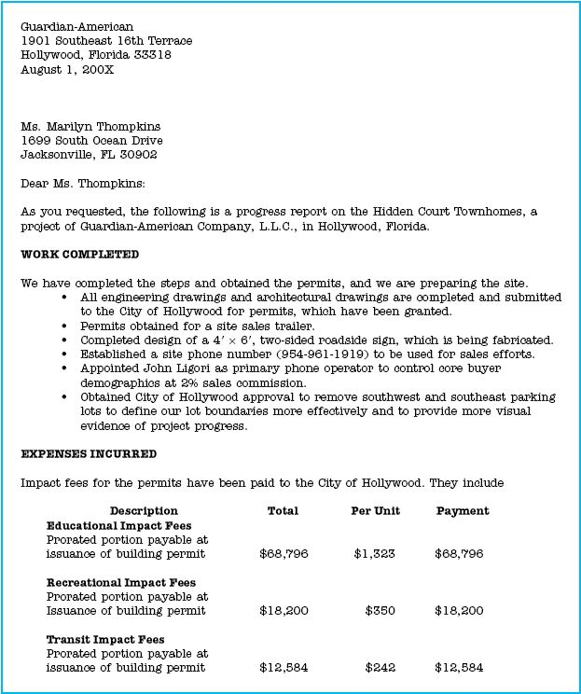
For Example

